Slide 1

Robotics Design And Competition
EN2532
Strategic Approach
Group 15

Slide 2
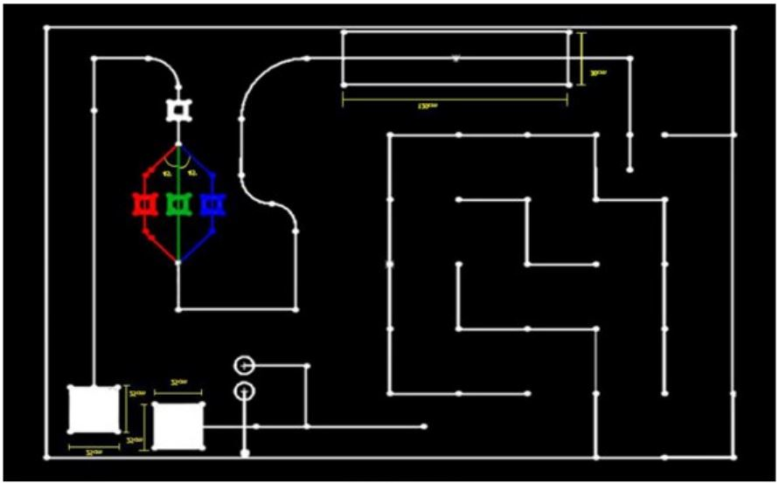
Overall Strategy
Line Following
Wall Following and Maze solving
Coin collecting and unloading
Water transfer

Slide 3
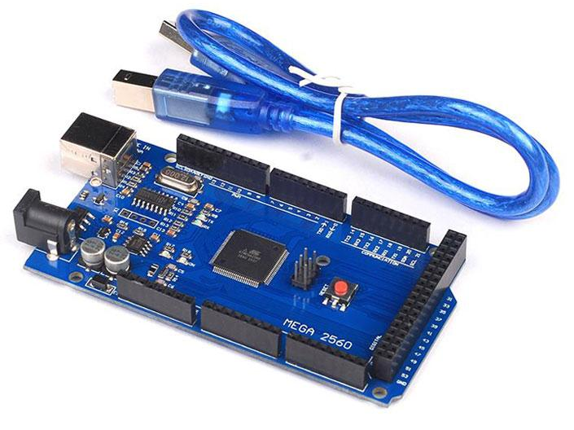
Robot Brain
Arduino Mega - Atmega2560
Pin allocation
Analog pins - IR sensors, Tilt sensors, Motor driver, Colour sensor
Digital pins - Sonar sensors, servo motors
Bluetooth communication with computer to reprogram

Slide 4
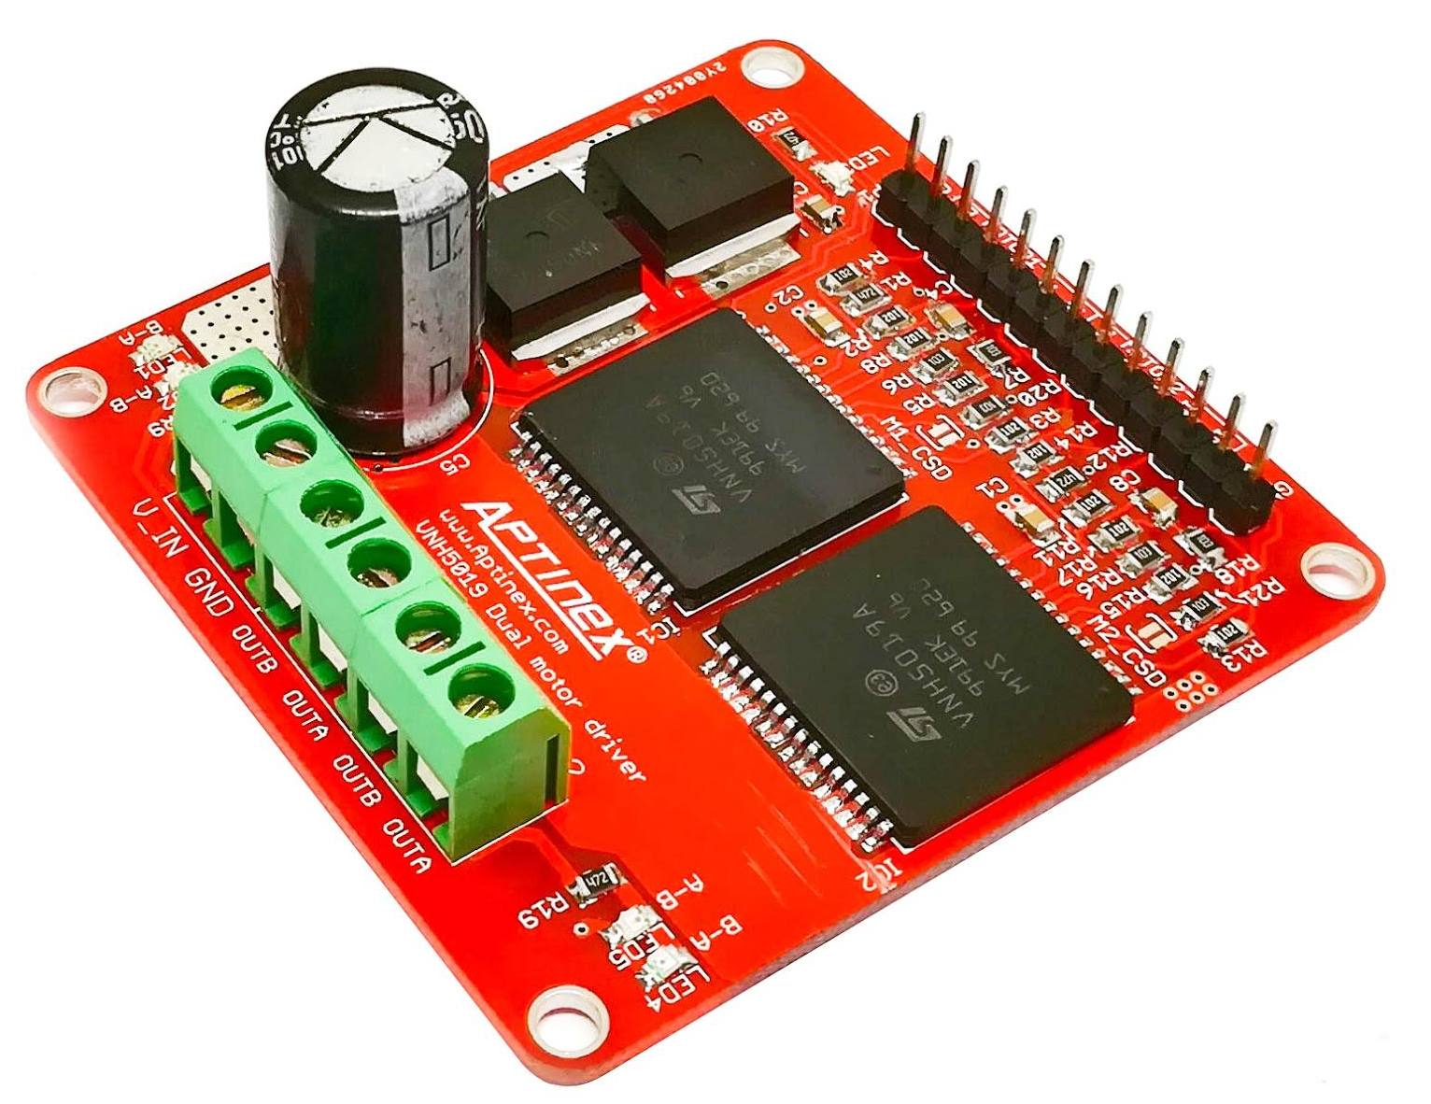
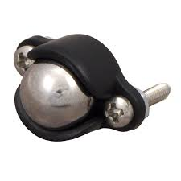
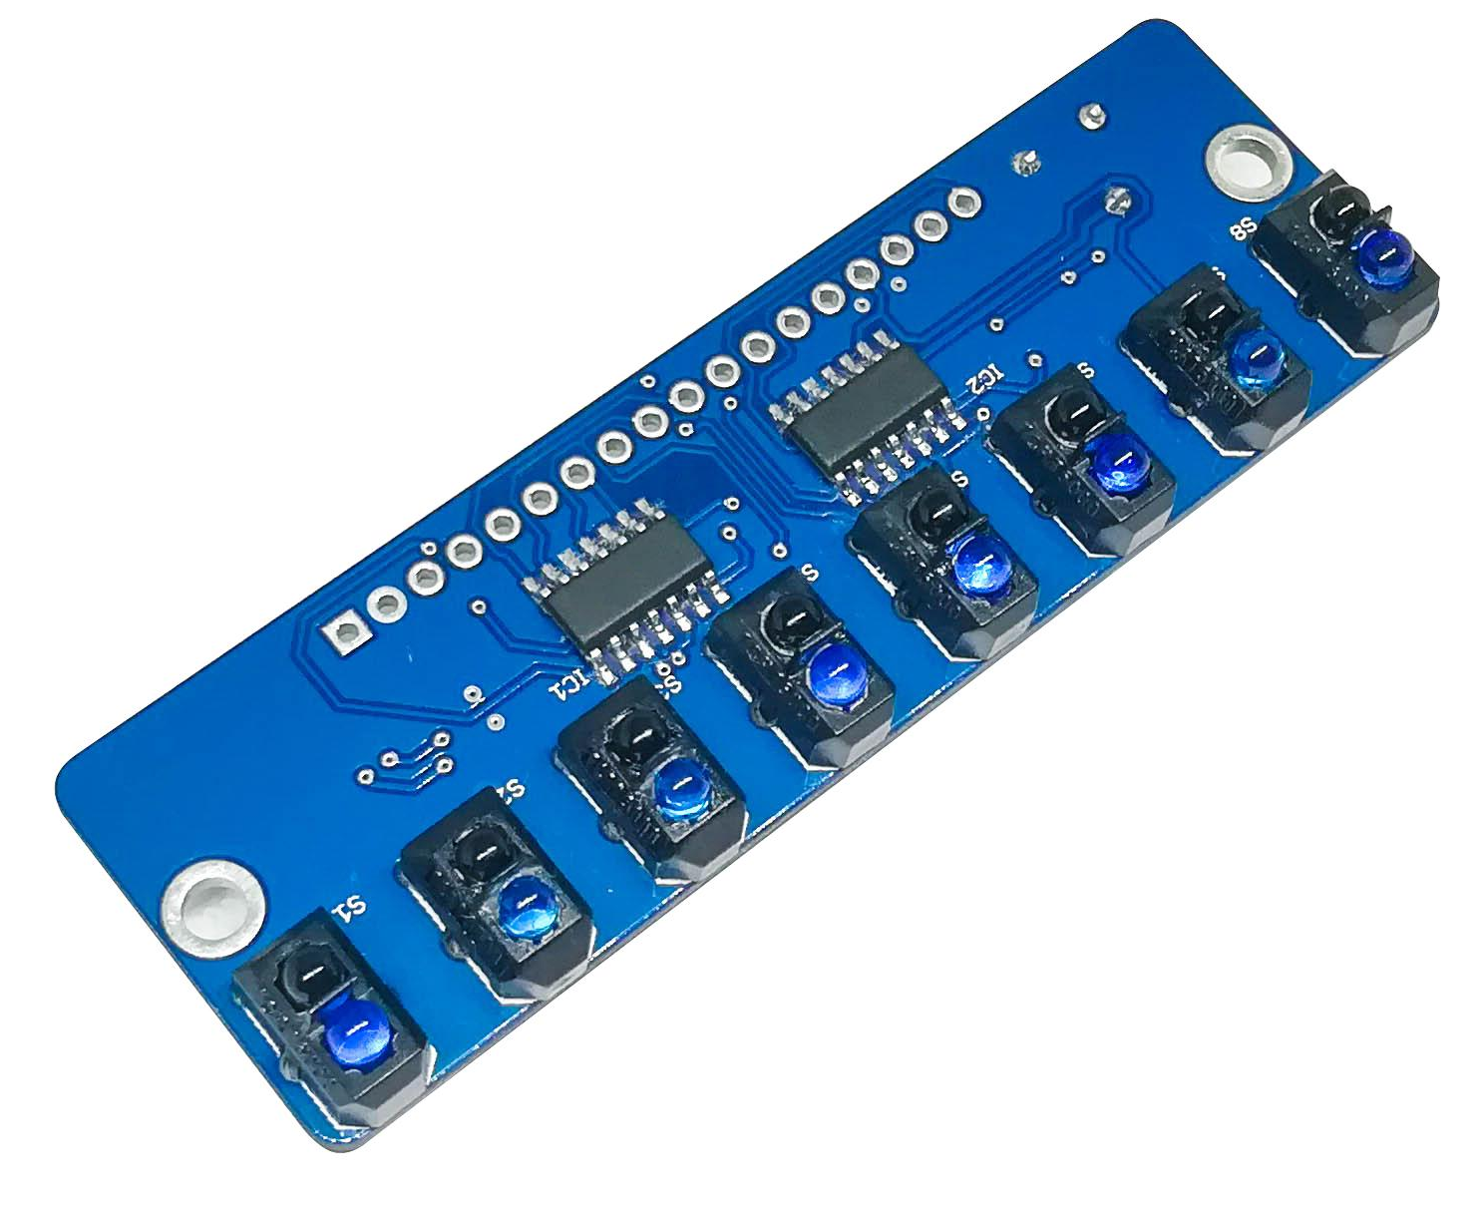
Line Following
Components
IR sensor panel - TCRT5000 based 8 channel Reflective Sensor Array
Two motors with encoders
Motor driver - VNH5019 Based Dual Motor Driver
Wheels - 50mm
Caster wheel
PID controlled
Tilt sensor to identify the ramp
Right hand rule as the line following strategy
Analog inputs - easy to follow a coloured line

Slide 5
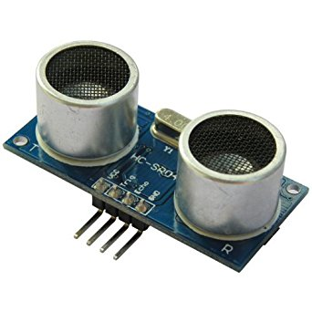
Wall following and maze solving
Components
Sonar sensors - three REES52 Ultrasonic range finder
** this will be the only difference from line following in component aspect
Sonar sensor inputs will used strategically in place of IR sensor panel inputs
Left hand rule to solve the maze

Slide 6
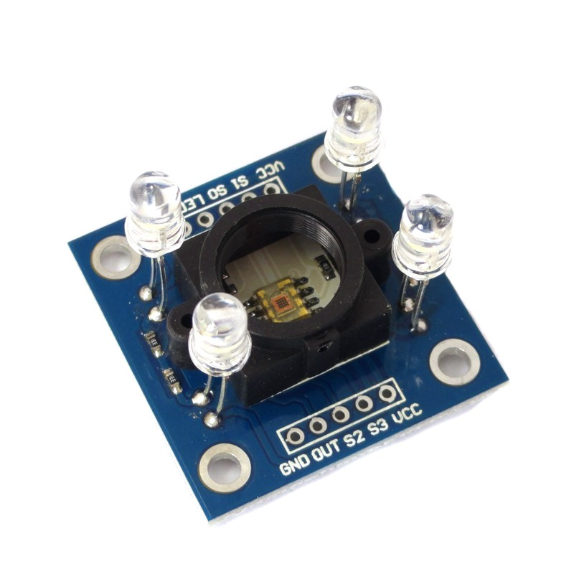
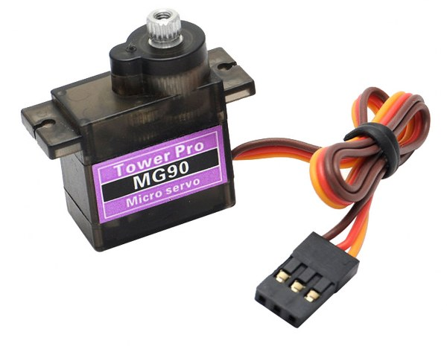
Coin collecting and unloading
Components
Permanent Magnets for coin collecting
Colour recognition sensor TCS3200 module (GY-31)
2 Servo Motors - Standard size(SG5010)
SG90 Tower Pro Micro Servo Motor
Strategy
collect the coin using a robot arm
unload the coin to a chamber to detect the colour
detect the colour using colour sensor in a closed room
unload the coin moving the base
TCS3200 colour sensor module

Slide 7
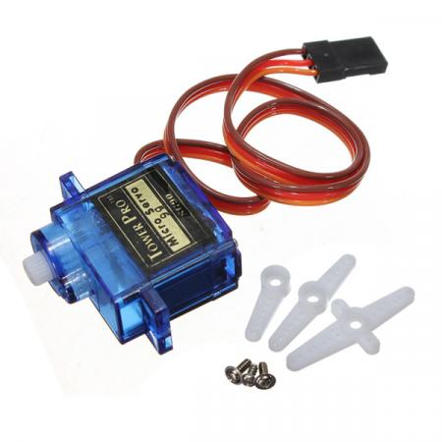
Water Transfer
Components
Pump
Servo Motor - Standard size(SG5010)
Water tubes
Strategy
An servo motor controlled arm is used to place the inlet and outlet of the pump
Pump water to the vessel using pump
**water volume is a pre-calculated water volume
SG5010 servo motor

Slide 8
Power System
Main power supply - 11.4 V LiPo rechargeable battery
11.3 V -5 V regulator module
Power supply panel - 5V, 11.4V, GND
On/Off switch for robot

Slide 9
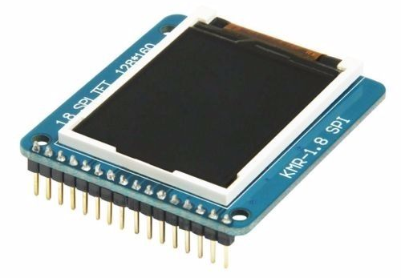
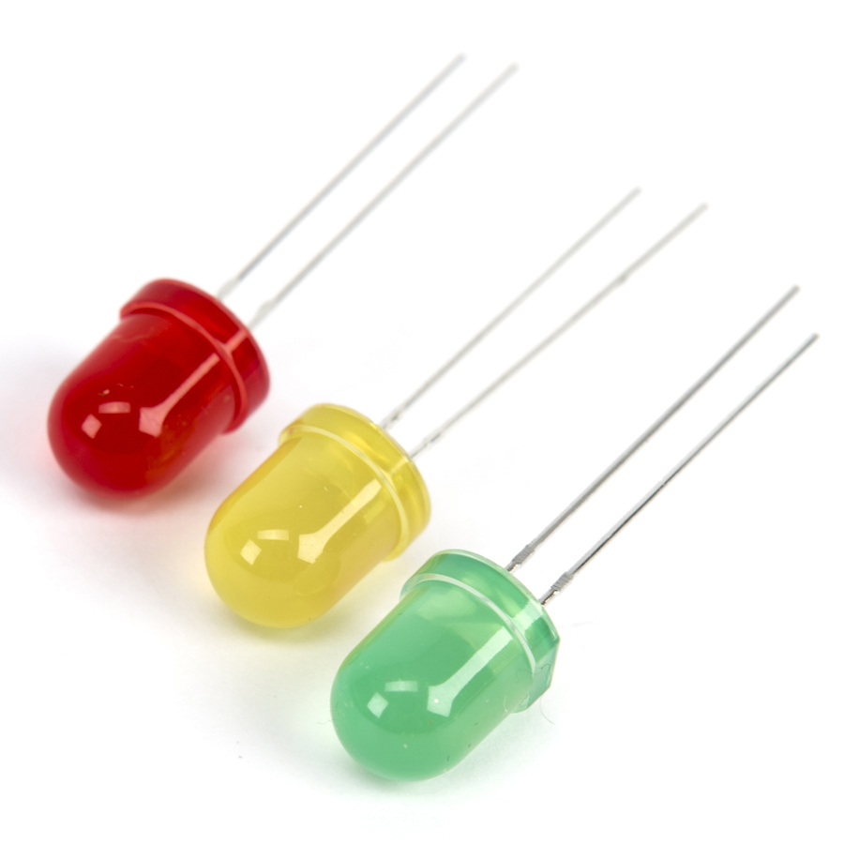
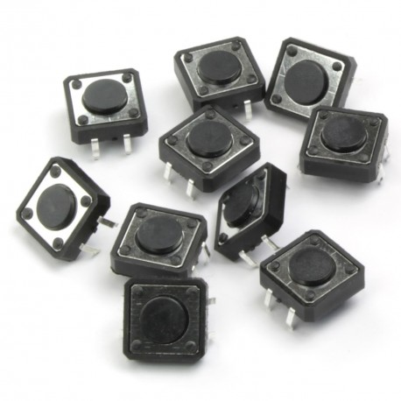
User Interface
LCD screen
Mode of the robot
Task completion
Push buttons
Mode selection
LED lights
Indicators

Slide 10
Task Delegation
Asitha -
Isuru -
Kavinda -
Dedunu -
Madubhashana -

